Slide 1

Heap Sort in C#

Slide 2
What is Heap Sort?
Heap sort is a sorting algorithm that uses a binary heap data structure.
It works by first creating a binary heap from the elements that we need to sort.

Slide 3
How to work?
Heap Sort is a sorting algorithm that makes use of the heap data structure. Each time the root element of the heap i.e. the largest element is removed and stored in an array. It is replaced by the rightmost leaf element and then the heap is reestablished.

Slide 4
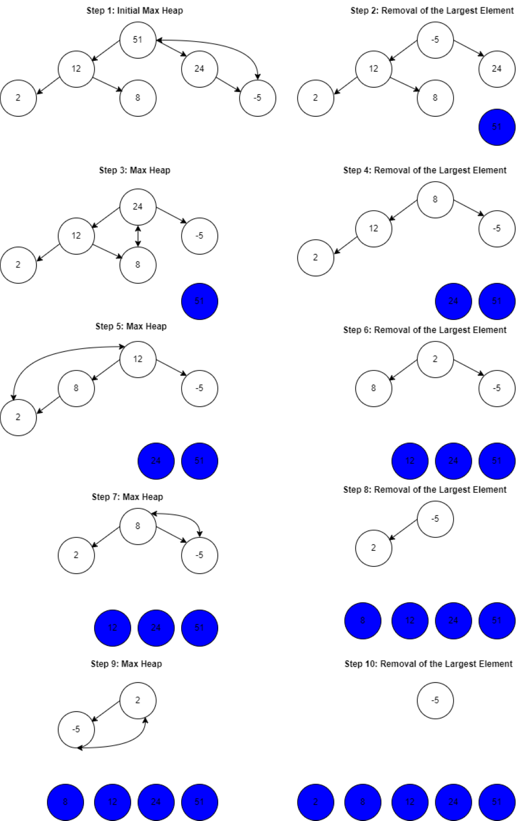
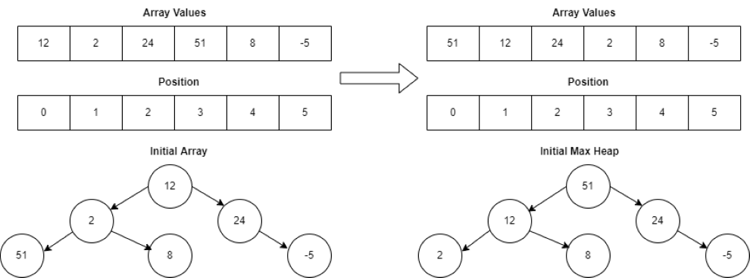
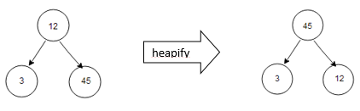
Example and explain of heap sort:
int[] array = {12, 2, 24, 51, 8, -5};
Example for heapify:

Slide 5
When is it useful?
✅ Heap sort has a time complexity of O(n log n), making it efficient for sorting large datasets.
✅ It has a space complexity of O(1) as it sorts the array in place, making it suitable for memory-constrained environments.
✅It is particularly useful when a stable sorting algorithm is not required.

Slide 6
Thank you for your attention!

